Slide 1

-FE Index

Slide 2

Review
According to the previous meeting on Sep 23th, I used reduced (i.e. 6) SHAP and CARS Features inside LDA (Since Michele suggested LDA has better accuracy over LR)
After a second talk with Michele, we now know that CARS features are also ordered. So, my question is this: “what method do we choose to reduce these 6 features”?
Our current problem seems like a voting (social choice theory) to me where each voter has his preferences but we need to make an aggregate decision on all voters’ preferences. Here, each methods (SVM etc.) is a voter and the features it proposes shows its preferences.
6 features for each of the methods is as following
SVM Features: ['723.53','929.68','720.54','726.53', '449.35','501.72']
LR Features: ['723.53','720.54','726.53','501.72','504.64', '929.68']
RF Features: ['702.58', '699.60', '714.55', '705.57', '525.10', '708.57']
LDA Features: ['598.60', '589.75', '616.34', '613.38', '681.69', '648.95']
CARS Features: ['452.25', '557.36', '690.64', '717.54', '744.53', '801.79']
There is not even 1 common feature between all of them

Slide 3
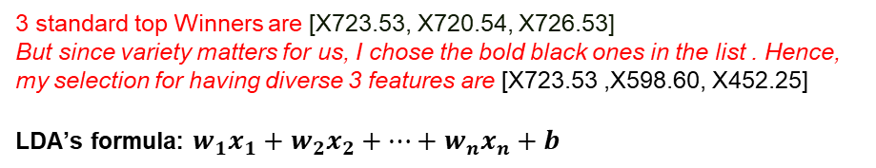
So, what do we do now?
If we use the voting method (called Borda method) :
Top 3 chosen features in this method are all from the 700th family. Features with higher vote (red number in front of each feature) are chosen as the winners.
Do you prefer this or going down in the list and pick features from other hundred families? or do you prefer manually choosing the one that ranks highest in feature lists (not in the list below)? Or all of them and a comparison at the end?
Final Borda scores:
723.53: 12
720.54: 9
726.53: 7
929.68: 6
702.58: 6
598.60: 6
452.25: 6
699.60: 5
589.75: 5
557.36: 5
501.72: 4
714.55: 4
616.34: 4
3 standard top Winners are [X723.53, X720.54, X726.53]
But since variety matters for us, I chose the bold black ones in the list . Hence, my selection for having diverse 3 features are [X723.53 ,X598.60, X452.25​]
LDA’s formula: $w_{1}x_{1}+w_{2}x_{2}+⋯+w_{n}x_{n}+b$
690.64: 4
705.57: 3
613.38: 3
717.54: 3
449.35: 2
504.64: 2
525.10: 2
681.69: 2
744.53: 2
708.57: 1
648.95: 1
801.79: 1

Slide 4


Accuracy results of using 6 features in LDA
Specim
Polypen
S.M.​ | C.M.​ | Accuracy​
 |  | All Crops​ | Tomato​ | Cucumber​ | Maize​ | Barley​ | Lupine​
CARS - 6​ | LDA​ | 0.94​ | 1.0​ | 0.75​ | ​0.55​ | ​0.98​ | 0.87​
SHAP - 6​ | SVM​ in LDA LDA​ RF​ in LDA LR​ in LDA | 0.96 0.85​ 0.​89 0.95 | 1.0 0.88​ 1.0​ 1.0​ | 0.62 0.62​ 0.75 0.​62 | 0.77 0.55​ 0.66 0.77 | 0.98 0.87 0.90 0.98 | 0.87 0.5​ 1.0 0.75
S.M. | N° W.​ | C.M.​ | Accuracy​
 |  |  | All Crops​ | Barley​ | Lupine​
CARS​ | 5 | LDA​​ | ​0.99 | ​0.96 | 0.​97
SHAP​ | 5​ | SVM​ in LDA | 0.​71 | 0.74​ | 0.41
 | 6​ | LDA​ | 0.85​ | 0.84​ | 0.97​
 | 6 | RF​ in LDA | 0.28 | 0.28 | 0.36
 | 5​ | LR​ in LDA | 0.​77 | 0.​77 | 0.55

Slide 5
Method 1 (by me): Accuracy results, using Voting features in LDA
Since the 3 top features in the voting method were all in 700th, I went down in the list (slide 3) and picked 3-4 top features from different hundreds. They are denoted in bold. The accuracies these features yield in LDA are listed below.
Selected features | Accuracy​, Specim
 | All Crops​ | Tomato​ | Cucumber​ | Maize​ | Barley​ | Lupine​
Voting – 3 X723.53 ,X598.60, X452.25​ | 0.93 | 1.0​ | 0.62 | ​0.55​ | ​0.94​ | 0.87​
Selected features | Accuracy​, Polypen
 | All Crops​ | Barley​ | Lupine​
Voting – 3 X723.53, X598.60, X452.25​ | ​0.92 | ​0.94 | 0.​97
Voting – 4 Index, Specim
F(x) = −0.889 + 1.408 ⋅ X723.53 + 2.094 ⋅ X598.60 − 1.220 ⋅ X929.68 + 0.284 ⋅ X452.25
Voting – 3 Index, Specim
F(x) = −0.785 + 0.860 ⋅ X723.53 + 2.731 ⋅ X598.60 − 0.876 ⋅ X452.25
Voting – 3 Index, Polypen
F(x) = −0.785 + 0.860 ⋅ X723.53 + 2.731 ⋅ X598.60 − 0.876 ⋅ X452.25

Slide 6
Method 2 (By A.A): Selecting the top 3 unique features from each hundred within each method’s set, and testing them in LDA
Selected features | Accuracy​, Specim
 | All Crops​ | Tomato​ | Cucumber​ | Maize​ | Barley​ | Lupine​
CARS – 3 X452.25, X557.36, X690.64​ | 0.92 | 1.0​ | 0.62 | ​0.66 | ​0.93 | 1.0
LDA-2 X598.6, X616.34​ | 0.92 | 1.0​ | 0.5 | 0.66 | 0.91 | 1.0
RF - 3 X702.58, X699.60, X525.10 | 0.92 | 1.0 | 0.62 | 0.55 | 0.93 | 0.87
LR – 3 X723.53, X501.72, X929.68 | 0.94 | 1.0 | 0.62 | 0.66 | 0.94 | 0.87
SVM – 3 X723.53, X929.68, X720.54 | 0.90 | 1.0 | 0.62 | 0.55 | 0.92 | 0.5
Selected features | Accuracy​, Polypen
 | All Crops​ | Barley​ | Lupine​
CARS – 3 X452.25, X557.36, X690.64​​ | 0.97 | 0.94 | 1.0
LDA-2 X598.6, X616.34​ | 0.98 | 0.96 | 1.0
RF - 3 X702.58, X699.60, X525.10 | 0.91 | 0.88 | 0.92
LR – 2 X723.53, X501.72, X929.68 | 0.94 | 0.93 | 1.0
SVM – 2 X723.53, X929.68, X720.54 | 0.93 | 0.91 | 0.98

Slide 7
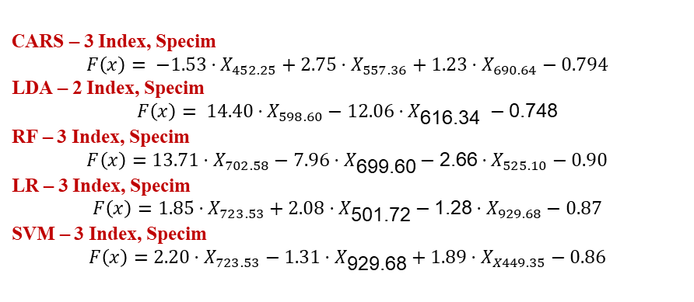
Method 2 (By A.A): Selecting the top 3 unique features from each hundred within each method’s set, and testing them in LDA
6 features for each of the methods is as following. Bold ones were chosen for index
CARS Features: ['452.25', '557.36', '690.64', '717.54', '744.53', '801.79']
LDA Features: ['598.60', '589.75', '616.34', '613.38', '681.69', '648.95']
RF Features: ['702.58', '699.60', '714.55', '705.57', '525.10', '708.57']
LR Features: ['723.53','720.54','726.53','501.72','504.64', '929.68']
SVM Features: ['723.53','929.68','720.54','726.53', '449.35','501.72']
CARS – 3 Index, Specim
$$F\left(x\right)= −1.53⋅X_{452.25}+2.75⋅X_{557.36}+1.23⋅X_{690.64}−0.794$$
LDA – 2 Index, Specim
$$F\left(x\right)= 14.40⋅X_{598.60}−12.06⋅X_{\text{616.34 }}−\text{0.748}$$
RF – 3 Index, Specim
$$F\left(x\right)=13.71⋅X_{702.58}−7.96⋅X_{\text{699.60}}−\text{2.66}⋅X_{525.10}−0.90$$
LR – 3 Index, Specim
$$F\left(x\right)=1.85⋅X_{723.53}+2.08⋅X_{\text{501.72}}−\text{1.28}⋅X_{929.68}−0.87$$
SVM – 3 Index, Specim
$$F\left(x\right)=2.20⋅X_{723.53}−1.31⋅X_{\text{929.68}}+1.89⋅X_{X449.35}−0.86$$

Slide 8

The end

